Slide 1
Accessories for the CS6080 Companion Scanners
By MSS Software

Slide 2
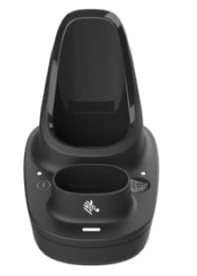
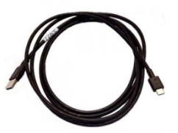
Accessories
Item: MCR6080-SC100F4WW For connecting your CS6080 to your PC as well as charging the device and one battery. USB Cord Sold Separately
Item: MCBL-CS6-S07-04
For connecting your CS6080 Dock to your PC.

Slide 3
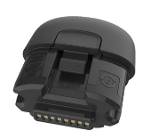
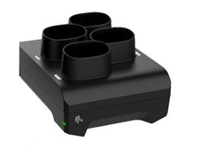
Accessories
Item: MBTRY-CS60EAB0E-04
Spare Battery for CS6080 Scanner
Item: MCR6080-BC40004WW
For charging up to 4 batteries for CS6080 Scanners. Power Cord sold separately.

Slide 4
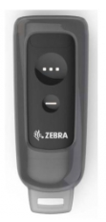
Accessories
Item: MHLSTR-SP0060W-00
Silicone protecter for CS6080

Slide 5
Service
MZ1AE-CS6080-3C00
MSS Software Service Contract for CS6080 Companion Scanner. Comprehensive Coverage, 3 Day Turn Around. Purchased within 30 Days of Device.

